Slide 1
PRODUCT SALES PREDCTION
AND SEGMENTATION
Team Details
Batch details | PGPDSE FT July 2022 (Chennai)
Team members | Ahamed basha Anish Kumar K Arif Hussain M.Khushi Rashika S
Domain of Project | Retail Analytics
Group Number | 4
Team Leader | Anish Kumar K
Mentor Name | Vidhya Kannaiah

Slide 2
Problem Definition
1.Business Problem Understanding:
The sales of each brand in amazon differs by order state, date, and other features. There are states where some brands have no sales and some brands find difficulties while selling their products and there are states where particular products are highly purchased too.
2. Business Objective:
The objective is to device a machine learning model to predict the total payment for each brand. The objective is to device a model to group the products based on their brands and the locality where they have been sold and prioritize the products based on the sales. Our objective is to find out which brands products is getting high sales.
3. Approach:
Data Understanding
Data Pre-Processing
Exploratory Data Analysis
Data Mining
Model Building
Model Evaluation
Model Optimization
Linear Regression – OLS, Ridge , Linear Regression, Decision Tree, Lasso etc
Unsupervised – K_means algorithm

Slide 3
Dataset Information:
Dataset consists of the several variables providing information about the sales with more than 31,936 rows and 23 columns in the data.
This is also the most vital set of information which would be used to segregate for train test split function later in order to check the accuracy.
DATA UNDERSTANDING:
Dataset consists of the several variables providing information about the sales.
Independent Variables:
Numerical Columns – 14
Categorical Columns – 8

Slide 4
INDEPENDENT VARIABLES:
Variable Name | Variable Descriptions
date/time | Date and time in UTC
Settlement id | Id of the settlement
Type | Type of Order
Order id | Indicates unique identity number for the orders
Brand Name | Name of the Brand
Sku | Stock Keeping Units
Description | Overview of the Product
Quantity | Number of ordered quantity
Account Type | Mode of Transaction
Fulfillment | Amazon or Merchant
Order state | State of Order placed
Order postal | Postal code
Amazon sales | Sales in Amazon
Shipping Credits | Shipping Charges
Promotional Rebates | Promotional or discounted Price
Total sales tax liable (GST before adjusting TCS) | Total GST before TCS
TCS-CGST | Central Goods and Service Tax
TCS-SGST | State Goods and Service Tax
TCS-IGST | Integrated Goods and Service Tax
Selling Fees | Selling charges to the company
Fba Fees | Fulfillment Charges
Other Transaction Fees | Transaction Charges
Total Payment | Total amount of Amazon sales with the Fees and Tax
DEPENDENT VARIABLE (TARGET VARIABLE):
Total Payment – Total Payment is the amount that is made by the customers after tallying with the GST, Shipping Credits, Selling Fees and Other Transaction Fees.

Slide 5
DATA PRE-PROCESSING:
We checked for the dtypes of the dataset and found that the date time column is in object so we changed that column dtype as datetime
In our dataset, we had around 111 duplicated records and we removed it for further analysis.
Segregated Date and Time from Date Time variable and created new column as Date and Time separately.
The Columns Order State and Order Postal has 998 null values and Order id has 22 null values and Fulfillment had 978 null values.
We separated the data wherever we had null values in Order state and Order Postal and did analysis on it.
Extracted the number of pieces from the Sku code and created a new column as ‘No. of Pieces’
We merged Shipping Credits, Promotional Rebates, Total Sales Tax Liable (GST before adj TCS), TCS_CGST, TCS_SGST, TCS_IGST, Selling Fees, Fba Fees, Other Transaction Fees these variables as charges of the order into one variable to avoid multicollinearity.
Created a new variable based on the Sku and transformed with five point summary statistics and saved it in new columns.
Now the shape of data is (30827 Rows and 34 Columns)

Slide 6
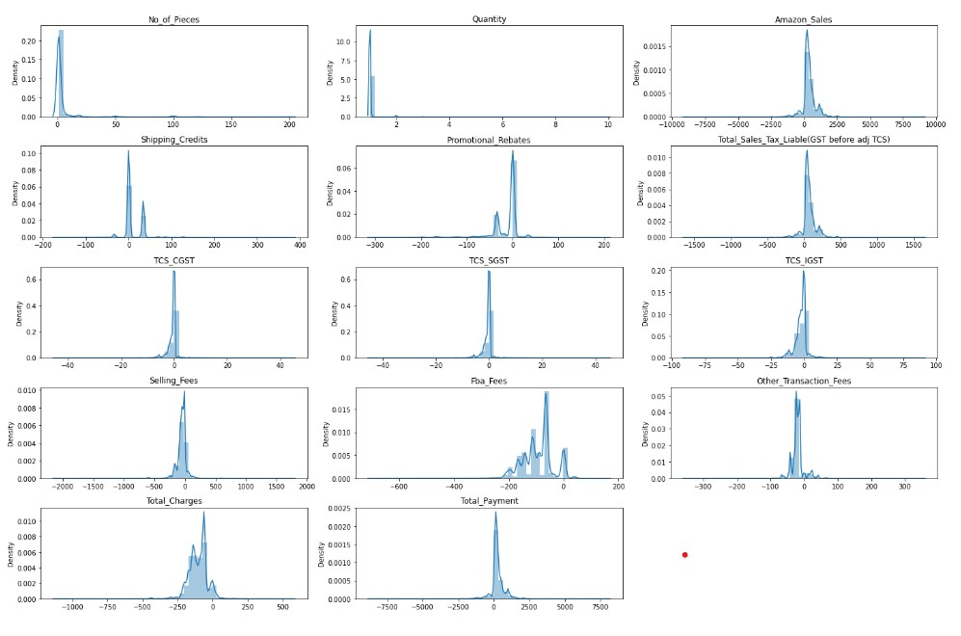
EXPLORATORY DATA ANALYSIS (EDA):
Univariate Analysis on Numerical Variables:
Inference:
Quantity is highly skewed towards right most of the orders ordered are 1 quantity.
These below columns are symmetrically skewed Amazon sales, Shipping Credits, Promotional Rebates, Total Sales Tax Liable (GST before adjusting TCS), TCS-CGST, TCS-SGST, TCS-IGST, Fba Fees, Other Transaction Fees, Total Fees.
The Selling Fees is slightly left skewed

Slide 7
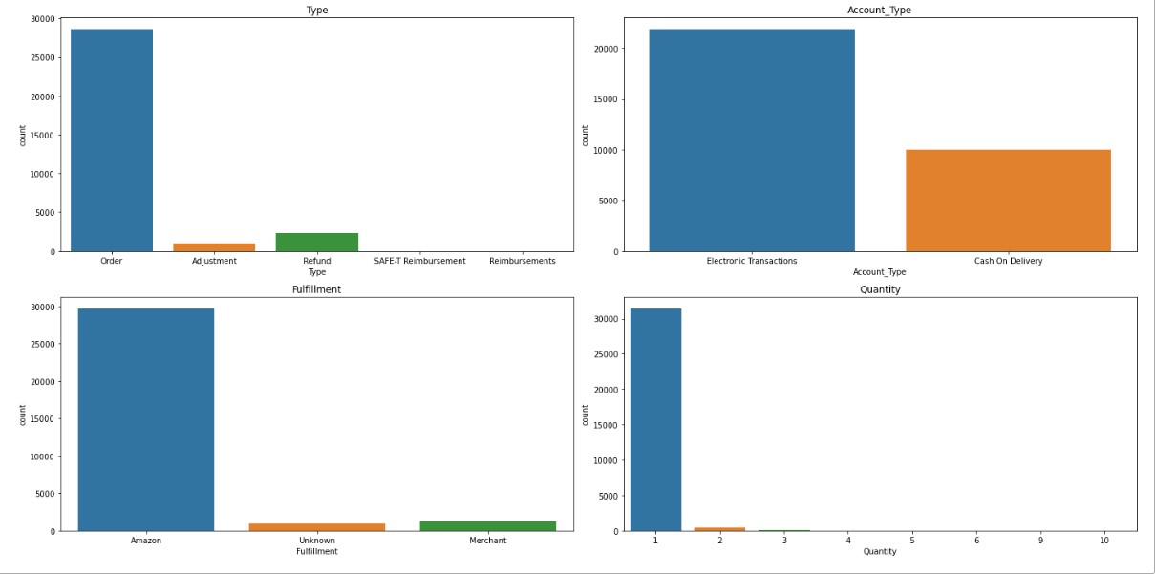
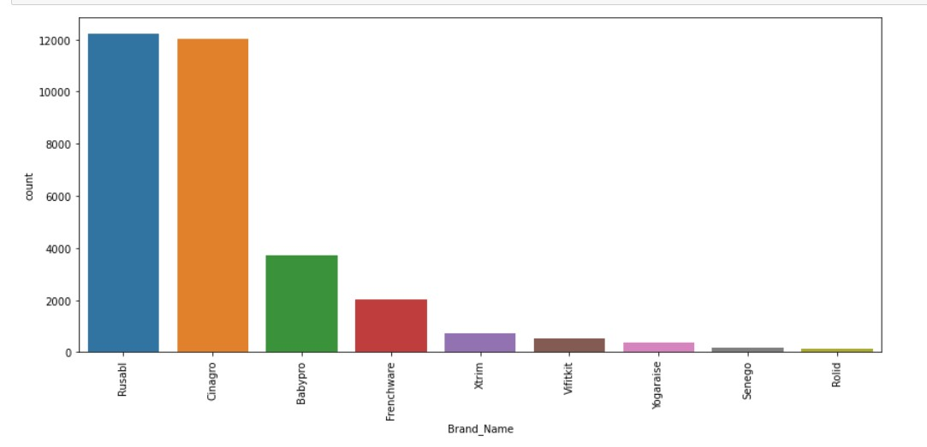
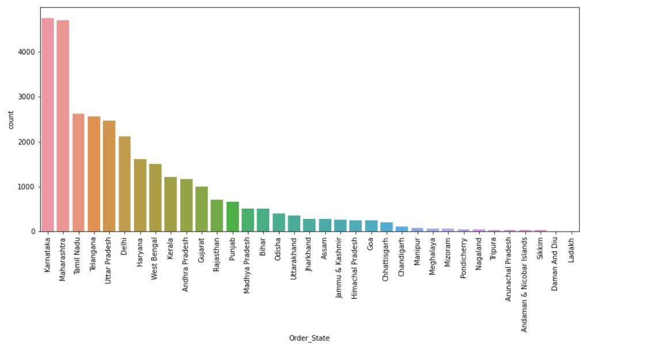
Univariate Analysis on Caterigorical Variables:
Inferences:
Rusabl and Cinagro Products are high number of selling products
Electronic Transactions are more preferrable
Most of the Sales are done by Amazon.
Inferences:
•The Products Rusabl and Cinagro have high number of sales.
•The Products Senego and Rolid has low number of sales.
Inferences:
•Most of the Sales happened in Karnataka and Maharashtra
•The States Daman & Diu and Ladakh are having low sales

Slide 8
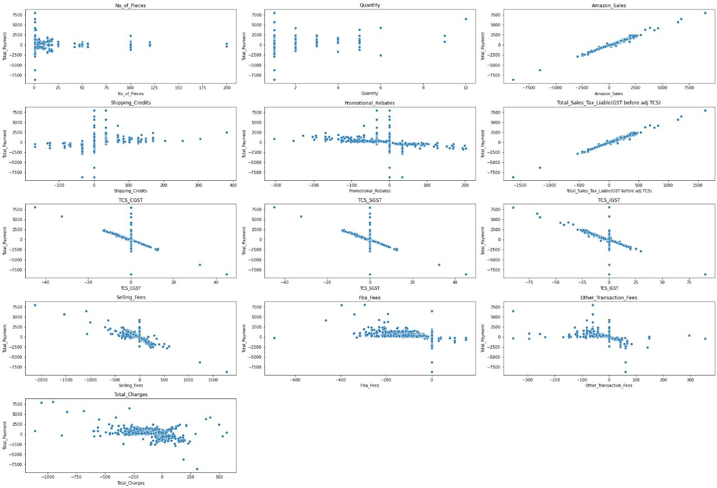
Bivariate Analysis on Numerical Variables:
Inferences:
•Total_Payment and 'Amazon Sales', 'Total_Sales_Tax_Liable (GST before adj TCS)' has linear relationship with each other.
•TCS_CGST, TCS_SGST, TCS_IGST and Total_Payment has negative linear relationship with each other.

Slide 9
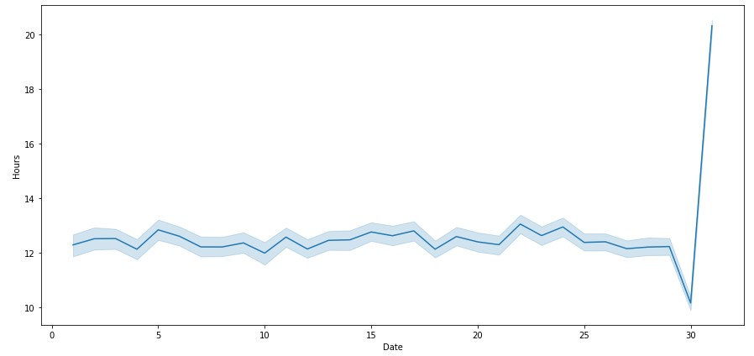
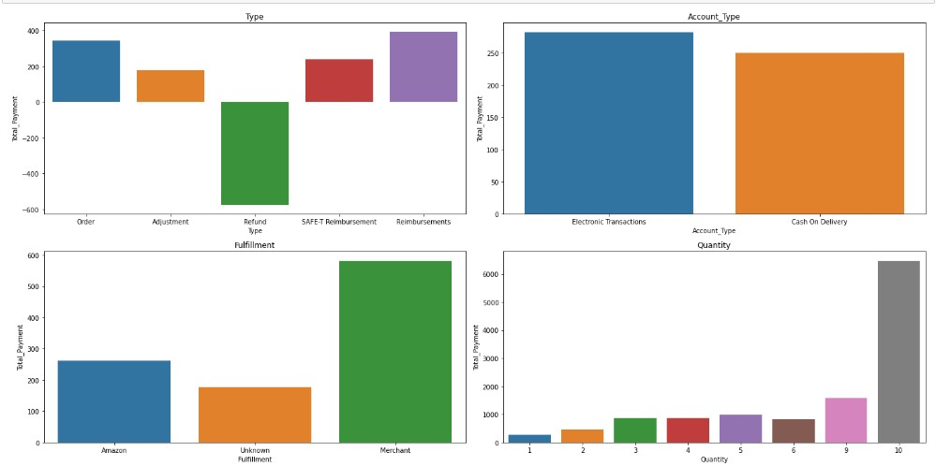
Hourly trend analysis for each day:
Inferences:
Most of the orders take place during the Noon hours of the Day
Bivariate Analysis on Categorical Variables:
Inferences:
The Total_Payment for Type Reimbursements are highly spent and the Refund type has negative spent of Total_Payments because those payments are refunded from the amazon to the customers.
Electric Transactions have high Total_Payment amount preferred by the customers compared to Cash on Delivery.
Merchant got the highest amount of Total_Payment.
The Quantity of 10 has highest Total_Payment.

Slide 10
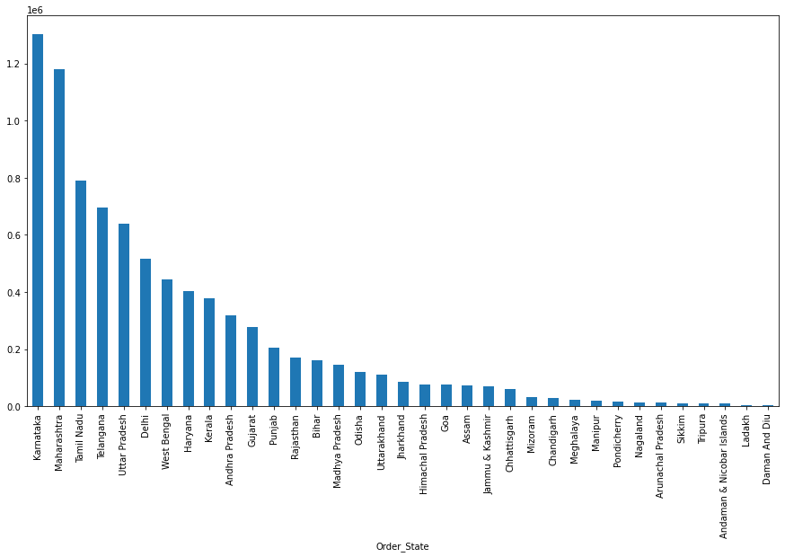
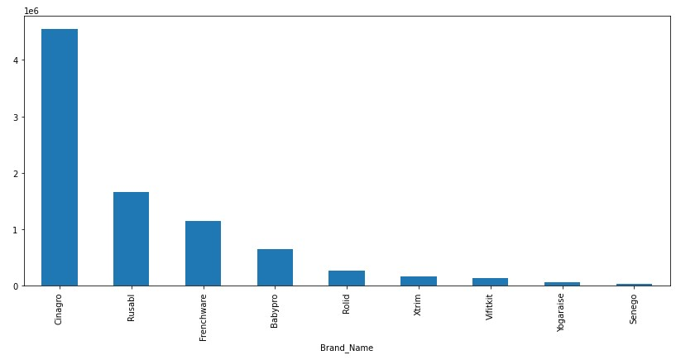
Total Payment for each State:
Inferences:
•The State Karnataka has highest sales around 13L.
•The State Daman and Diu has lowest sales around 3K.
Total Payment for Each Brand:
Inferences:
The Brand Cinagro has highest sales around 45L.
The Brand Senego has lowest sales around 39K.

Slide 11
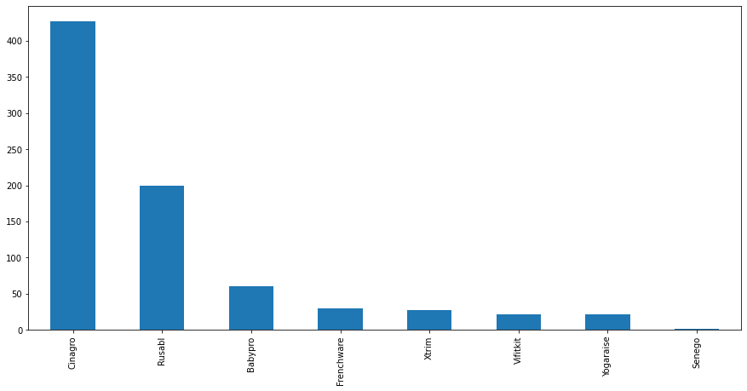
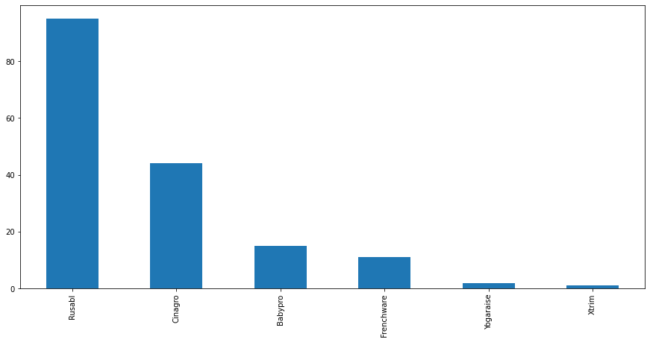
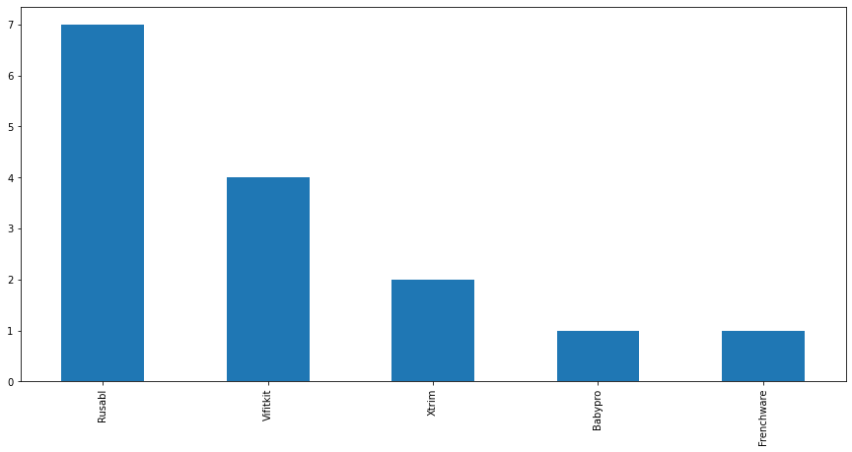
Analysis of records where Order State and Order Postal has Null Values:
Plotted the no of orders returned due Customer Return for each brand
Plotted of the no of orders returned due Customer Service Issue for each brand
Inferences:
Except Rolid all other brands are getting customer return whereas Cinagro has highest no of returns.
Inferences:
Rusabl has high customer service issues than all other brands.
Rolid, Vifitkit, Senego has no customer service issue.
Plotted the no of orders returned due to Reimbursement issued for lost or damaged package for each brand
Inferences:
Rusabl has the highest number of lost or damaged package delivery followed by Vifitkit.

Slide 12
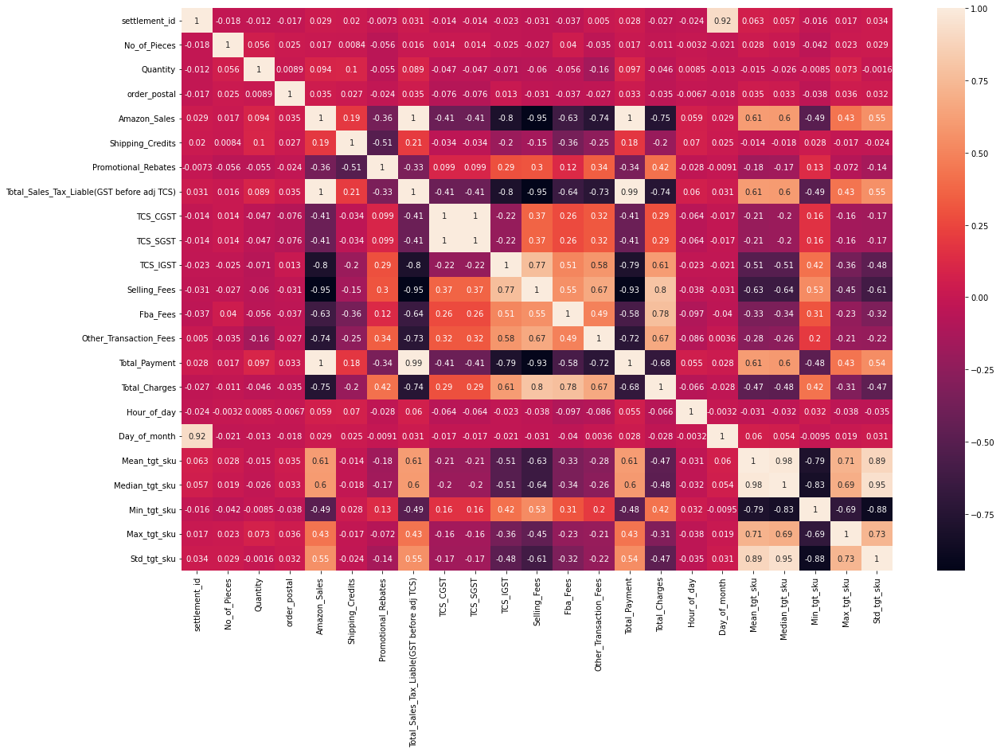
Heatmap:
Inferences:
The Target variable has high correlation between amazon sales, Total_Sales_Tax. So before model building we need to remove those columns
The Target variable has negative correlation between GST columns, Selling Fees, FBA fees

Slide 13
STATISTICAL TESTS:
PARAMETRIC TEST:
1. T - Test: Hypothesis testing between Total_Payment feature and other numerical features • H0: Both groups have equal mean indicating that they are insignificant. • H1: Both groups do not have equal mean indicating that they are significant.
The significant features are No of Pieces, Quantity, Amazon Sales, Shipping Credits, Promotional Rebates, Total Sales Tax Liable (GST before adj TCS), TCS-CGST, TCS-SGST, TCS-IGST, Selling Fees, Fba Fees, Other Transaction Fees, Other fees, Total Charges, Total Ad Spent, Median_tgt_sku, Min_tgt_sku, Max_tgt_sku.
2. Anova test of Brand Name and total Payment:
Ho: there is no effect of Brand Name on total fees
Ha: there is effect of Brand Name on total fees
Inferences:
By Jarque-Bera test, we can see that data is not normally distributed.
By Levene test, we see that variance is equal.
Since P-value < 0.05 and f_alpha < statistics, we reject the null hypothesis, that is, hence there is affect of Brand Name on total fees.
NON-PARAMETRIC TEST:
1. Mannwhitneyu:
Since the data is not normally distributed, we are proceeding with non-parametric test. • Ho: The feature does not carry any significance for the target. • Ha: The feature is significant variable for the target.
Inferences:
•Since, the p-value < 0.05, for all numerical variables, we reject the numerical variables.
•Hence, it means these variables are significant for the target. So no columns to be dropped before model building.
2. Kruskal Test:
Inferences:
•Since, p-value < 0.05, both non-parametric test, that means all variables are significant.

Slide 14
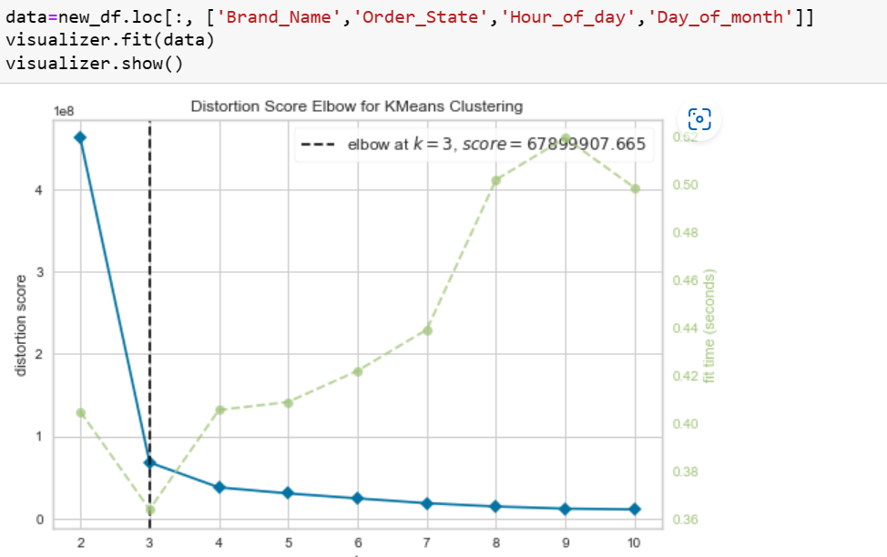
SCALING:
Using StandardScaler we scaled Total_Charges, Mean_tgt_sku, Median_tgt_sku, min_tgt_sku, Max_tgt_sku.
ENCODING:
We have done Target encoding for Brand Name Variable with Median values.
We have done Target encoding for Order State Variable with Median values.
We have done One Hot encoding for Type Account, Type, Fulfillment.
SEGMENTATION:
Inference:
Using KElbow Visualizer for the data of Brand Name, Order State, Hour of day, Day of month ,we found that specific number of Cluster for these columns are Three.
Then we done the segmentation for these data with 3 clusters as Labels

Slide 15
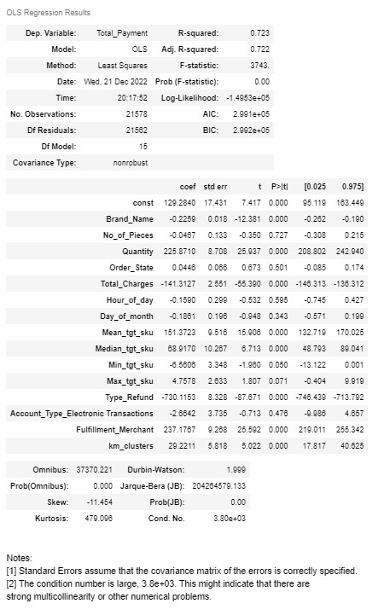
MODEL BUILDING:
Stats model as Base model:
Inference:
We found that R-squared value for Linear Regression as base model is 0.723 and Adj.R-Squared value is 0.722
The Significance variable is Brand_Name, Quantity, Total_charges, Mean_tgt_sku, Median_tgt_sku, Type_Refund, Fulfillment_Merchant, km_clusters.

Slide 16
ASSUMPTION TEST:
1.Linearity - Rainbow Test:
By doing the Rainbow test for linearity, we found that data doesn’t have linear relation with target variable.
2.Normality Test- Jarque Bera Test:
By doing the Jarque bera test for normality, we found that data is not normally distributed.
3.Multicollinearity Test -VIF:
By doing VIF(Variance Inflation Factor) for Multicollineariaty we found that Quantity ,Order state , Mean_tgt_sku , Median_tgt_sku having multicollineariaty.
4.Hetroskedasticity - Breusch–Pagan Test:
By doing Breusch–Pagan test , we found that there is Hetroskedastcity pattern.
5.Autocorrelation of Errors – Durbin Watson Test:
By doing Durbin Watson Test for Autocorrelation of Errors we found that there’s positive Autocorrelation.

Slide 17
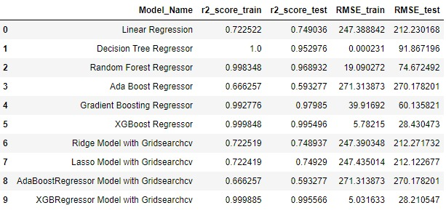
MODEL BUILDING RESULTS:
For Linear regression model we found that R2 score for train is 0.72 and r2 score for test data is 0.74, RMSE for train in 247.38 and test is 212.23
For Ada boost regressor model we found that R2 score for train is 0.66 and r2 score for test data is 0.59, RMSE for train in 271.31 and test is 270.17
For Gradiant Boost regressor model we found that R2 score for train is 0.99 and r2 score for test data is 0.97, RMSE for train in 39.91 and test is 60.13
For XG Boost regressor model we found that R2 score for train is 0.99 and r2 score for test data is 0.99, RMSE for train in 5.78 and test is 28.43
For Ridge model we found that R2 score for train is 0.72 and r2 score for test data is 0.74, RMSE for train in 247.39 and test is 212.27
Ada Boost Regressor and Gradiant Boost Regressor are good models compared to other models

Slide 18
Conclusion:
We found that Cinagro have highest sales in Harayana compared to other brands and Senego and Xtrim have the negative sales in Megalaya because they have more return orders so company has to focus on those type of orders.
Rusabl is having more customer service issue and loss inbound orders compared to other brands, so they need to work on customer service.
Amazon sales of these brands are very less in Andaman n Nicobar , Ladakh and Damen and Diu, so they need to focus on marketing activities.
We found that Cinagro have highest sales than other brands ,so they do have more FBA Inventory Reimbursement (Customer Return). So they can open a Storage facility and they can delivery products at least possible time and there will be less product inbounds and if still damage happens, they can make replacement of that product instead of giving a refund to the customer.
Thanks!!

